Slide 1

City Website Proposal
Group 3: Assessment 3 IN0006

Slide 2
Group Participants
Nabila Ahadi
Tousif Malique
Warda Hussein
Sara Boumrah

Slide 3
Overview
01
04
02
05
03
06
Project Plan
Site map
Roles and Responsibilities
Wireframe
Research data
Mock-up Designs

Slide 4
Project Plan
Our aims
To design a responsive university website for potential students of City’s computer science foundation course
The website aims to be well designed, informative, visually appealing, user-friendly and target “students” as the main demographic.
Should allow students to navigate through the different pages.
Pages include:
Home page
Course Overview page- with a Student Life sub-section
Contact page
About Us

Slide 5
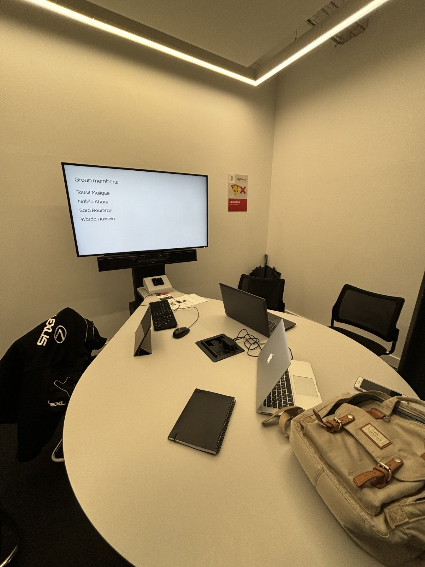
Group Meetings
Web development labs
12/12/23 - Law library T129 3pm

Slide 6

Roles & Responsibilities
Project Manager
Tousif
The project manager's first responsibility must be to organise the group and the overall project. This includes developing a well thought out and methodological project plan. They must assign tasks to each member and set deadlines for them to meet. They should have good communication throughout the project and address any challenges and solutions to overcome them.
Designer
Nabila and Sara
The designers main responsibility should be to create the visual look of the website. This includes setting the layout, colour scheme, font and overall aesthetic of the website. They must create well designed wireframes which can be passed onto the developers and understood by them easily.
Researcher
Warda
The main job for the researcher should be to gather information and resources needed for the project. They should research and gather information from similar websites and analyse the target audience and provide valuable information to guide the decision-making in the project.
Developer
All group members
The main task for the developers would be to build the technical structure of the website using html and CSS. This of course includes all the members of the group. They will be assigned to design certain pages. Their pages will be assigned by the project manager and the layout of the webpage will be structured following the designers plan.

Slide 7
Roles & Responsibilities
Project Manager
Tousif
The project manager's first responsibility must be to organise the group and the overall project. This includes developing a well thought out and methodological project plan. They must assign tasks to each member and set deadlines for them to meet. They should have good communication throughout the project and address any challenges and solutions to overcome them.
Designer
Nabila and Sara
The designers main responsibility should be to create the visual look of the website. This includes setting the layout, colour scheme, font and overall aesthetic of the website. They must create well designed wireframes which can be passed onto the developers and understood by them easily.
Researcher
Warda
The main job for the researcher should be to gather information and resources needed for the project. They should research and gather information from similar websites and analyse the target audience and provide valuable information to guide the decision-making in the project.
Developer
(All group members)
The main task for the developers would be to build the technical structure of the website using html and CSS. This of course includes all the members of the group. They will be assigned to design certain pages. Their pages will be assigned by the project manager and the layout of the webpage will be structured following the designers plan.

Slide 8
Roles & Responsibilities
Project Manager
Tousif
The project manager's first responsibility must be to organise the group and the overall project. This includes developing a well thought out and methodological project plan. They must assign tasks to each member and set deadlines for them to meet. They should have good communication throughout the project and address any challenges and solutions to overcome them.
Designer
Nabila and Sara
The designers main responsibility should be to create the visual look of the website. This includes setting the layout, colour scheme, font and overall aesthetic of the website. They must create well designed wireframes which can be passed onto the developers and understood by them easily.
Researcher
Warda
The main job for the researcher should be to gather information and resources needed for the project. They should research and gather information from similar websites and analyse the target audience and provide valuable information to guide the decision-making in the project.
Developer
All group members
The main task for the developers would be to build the technical structure of the website using html and CSS. This of course includes all members of the group. They will be assigned to design certain pages. Their pages will be assigned by the project manager and the layout of the webpage will be structured following the designers plan.

Slide 9
Roles & Responsibilities
Project Manager
Tousif
The project manager's first responsibility must be to organise the group and the overall project. This includes developing a well thought out and methodological project plan. They must assign tasks to each member and set deadlines for them to meet. They should have good communication throughout the project and address any challenges and solutions to overcome them.
Designer
Nabila and Sara
The designers main responsibility should be to create the visual look of the website. This includes setting the layout, colour scheme, font and overall aesthetic of the website. They must create well designed wireframes which can be passed onto the developers and understood by them easily.
Researcher
Warda
The main job for the researcher should be to gather information and resources needed for the project. They should research and gather information from similar websites and analyse the target audience and provide valuable information to guide the decision-making in the project.
Developer
All group members
The main task for the developers would be to build the technical structure of the website using html and CSS. This of course includes all members of the group. They will be assigned to design certain pages. Their pages will be assigned by the project manager and the layout of the webpage will be structured following the designers plan.

Slide 10
Research Data
Section 03

Slide 11
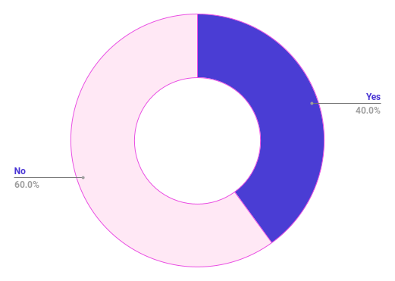
Interview results & Analysis
1. What information are you looking for/ need when browsing a university website?
2. What information would you like to see on the about page of the university?
3. Does the design of a university website influence your decision of attending that university? If so, what design style do you look for?
4. What contact information would be most useful on this website (i.e., telephone, form, email)?
5. Would you find a list of prerequisite skills helpful in preparing for university and why?
Yes
No
The most desired information includes module outlines, course requirements, entry requirements, application process steps, faculty contact details, course structure, and assessment methods.
These details are planned to be included under 'Course Details'.
Desired information includes a summary of class conduct, course overview, and details about exam dates and formats (online, in-class, etc.).
The type of contact information considered most useful depends on the user's query.
Telephone details were prioritized for quick resolution of issues.
Email and contact forms were also deemed important.
All relevant contact information must be present on the website.
A clear overview of required skills is valued for helping students prepare.
Respondents appreciated a list of skills to practice before enrolling, particularly during the summer before university starts.
Some stated content is more important than design.
Others looked for consistency in colour palette.
A few mentioned that some reputable universities have poor websites, implying design is not a major factor.
Scattered content was seen as an issue, while well-organized design seemed to indicate the university's commitment.

Slide 12
Interview results & Analysis
1. What information are you looking for/ need when browsing a university website?
2. What information would you like to see on the about page of the university?
3. Does the design of a university website influence your decision of attending that university? If so, what design style do you look for?
4. What contact information would be most useful on this website (i.e., telephone, form, email)?
5. Would you find a list of prerequisite skills helpful in preparing for university and why?
Yes
No
The most desired information includes module outlines, course requirements, entry requirements, application process steps, faculty contact details, course structure, and assessment methods.
These details are planned to be included under 'Course Details'.
Desired information includes a summary of class conduct, course overview, and details about exam dates and formats (online, in-class, etc.).
The type of contact information considered most useful depends on the user's query.
Telephone details were prioritized for quick resolution of issues.
Email and contact forms were also deemed important.
All relevant contact information must be present on the website.
A clear overview of required skills is valued for helping students prepare.
Respondents appreciated a list of skills to practice before enrolling, particularly during the summer before university starts.
Some stated content is more important than design.
Others looked for consistency in colour palette.
A few mentioned that some reputable universities have poor websites, implying design is not a major factor.
Scattered content was seen as an issue, while well-organized design seemed to indicate the university's commitment.

Slide 13
Interview results & Analysis
1. What information are you looking for/ need when browsing a university website?
2. What information would you like to see on the about page of the university?
3. Does the design of a university website influence your decision of attending that university? If so, what design style do you look for?
4. What contact information would be most useful on this website (i.e., telephone, form, email)?
5. Would you find a list of prerequisite skills helpful in preparing for university and why?
Yes
No
The most desired information includes module outlines, course requirements, entry requirements, application process steps, faculty contact details, course structure, and assessment methods.
These details are planned to be included under 'Course Details'.
Desired information includes a summary of class conduct, course overview, and details about exam dates and formats (online, in-class, etc.).
The type of contact information considered most useful depends on the user's query.
Telephone details were prioritized for quick resolution of issues.
Email and contact forms were also deemed important.
All relevant contact information must be present on the website.
A clear overview of required skills is valued for helping students prepare.
Respondents appreciated a list of skills to practice before enrolling, particularly during the summer before university starts.
Some stated content is more important than design.
Others looked for consistency in colour palette.
A few mentioned that some reputable universities have poor websites, implying design is not a major factor.
Scattered content was seen as an issue, while well-organized design seemed to indicate the university's commitment.

Slide 14
Website Design
Section 03

Slide 15
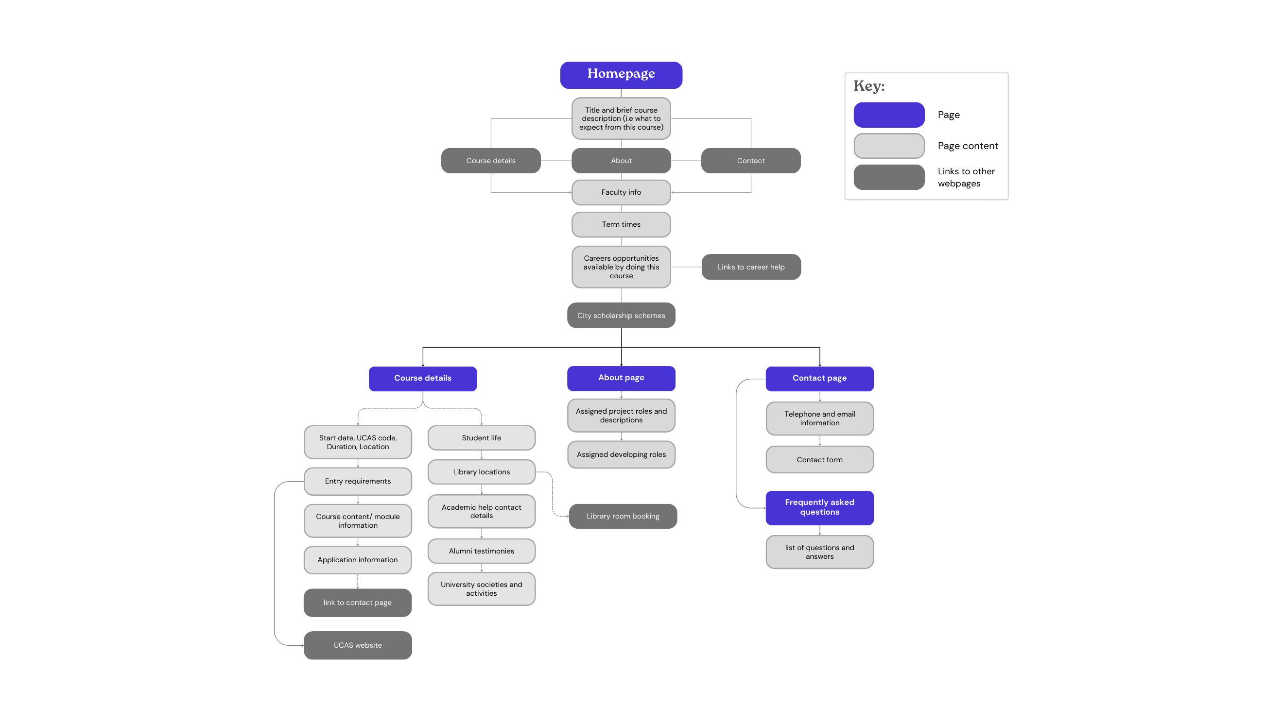
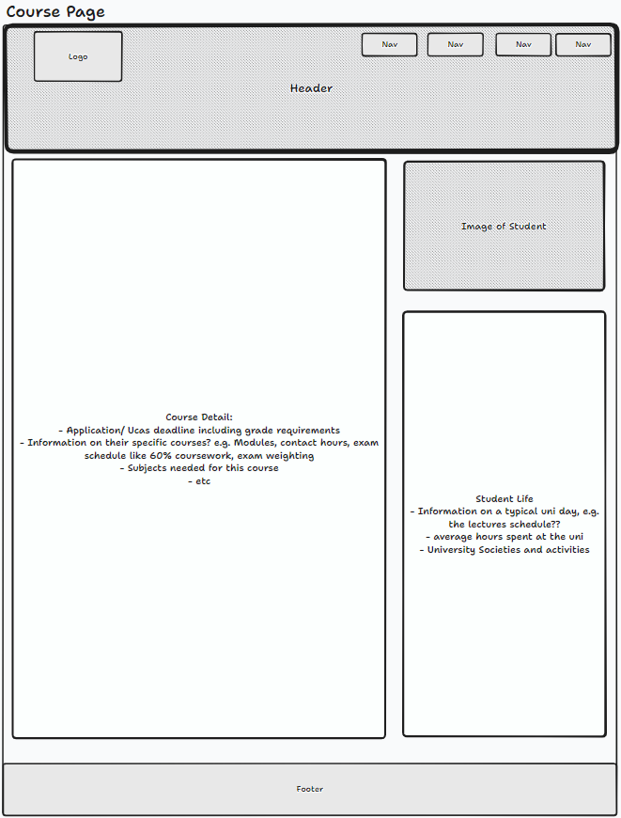
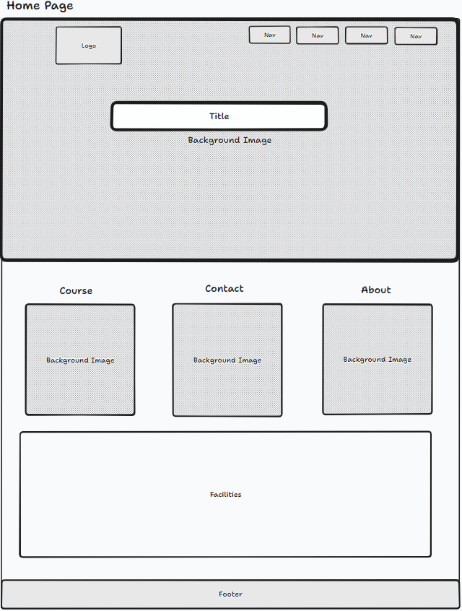
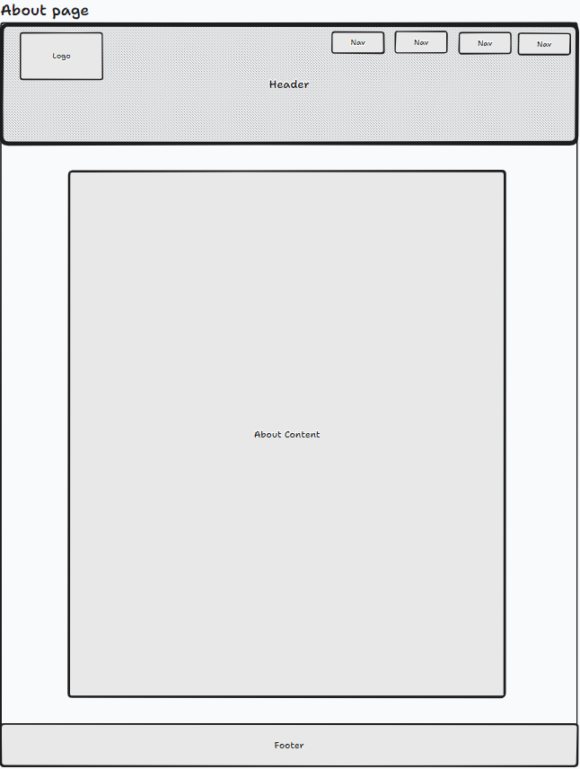
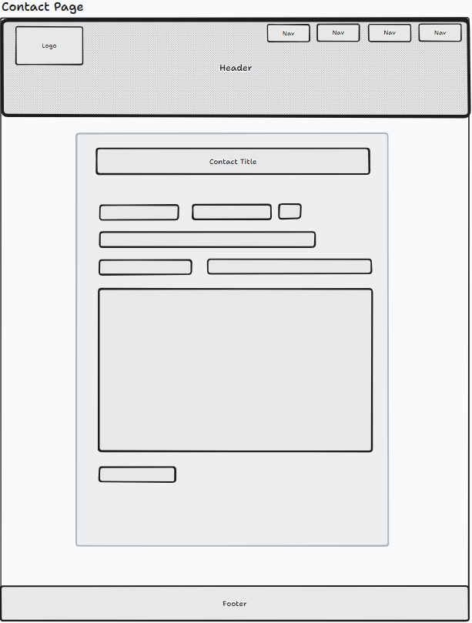

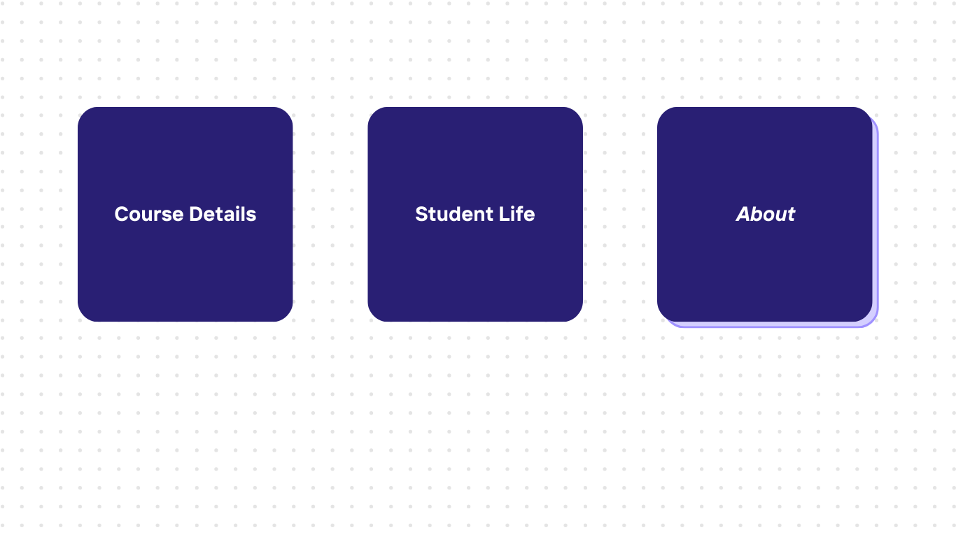
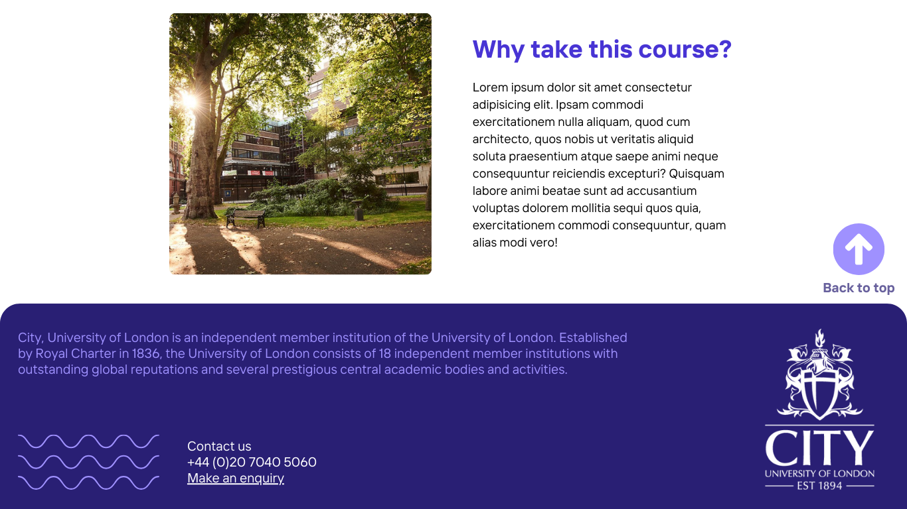
Sitemap
Wireframes
Mock-up design

Slide 16
Sitemap
Wireframes
Mock-up design

Slide 17

Sitemap
Wireframes
Mock-up design

Slide 18
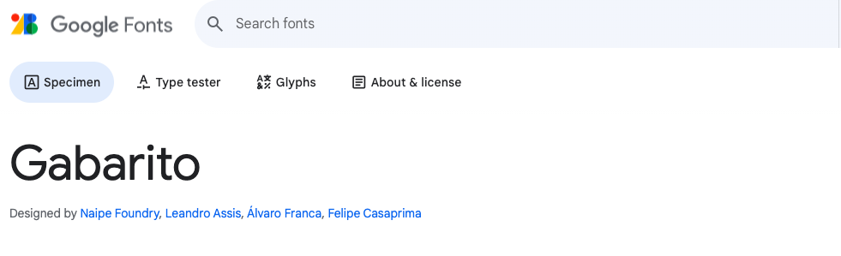


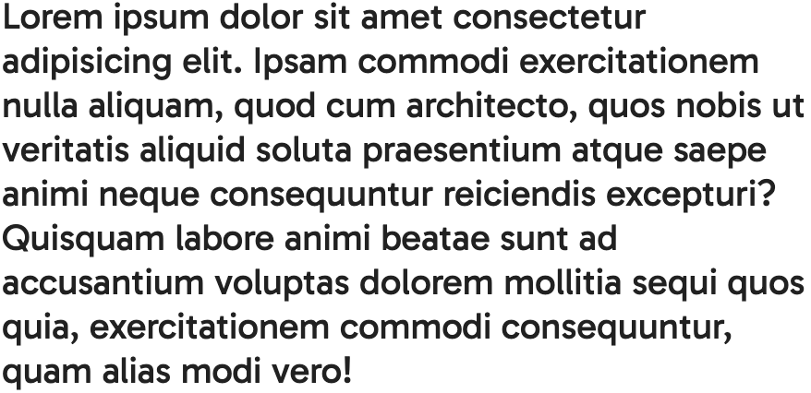
Typography

Slide 19
Colour scheme
#000000
#291f74
#4834d4
# 9f91ff

Slide 20
Mock-up Designs
Mobile & Desktop

Slide 21

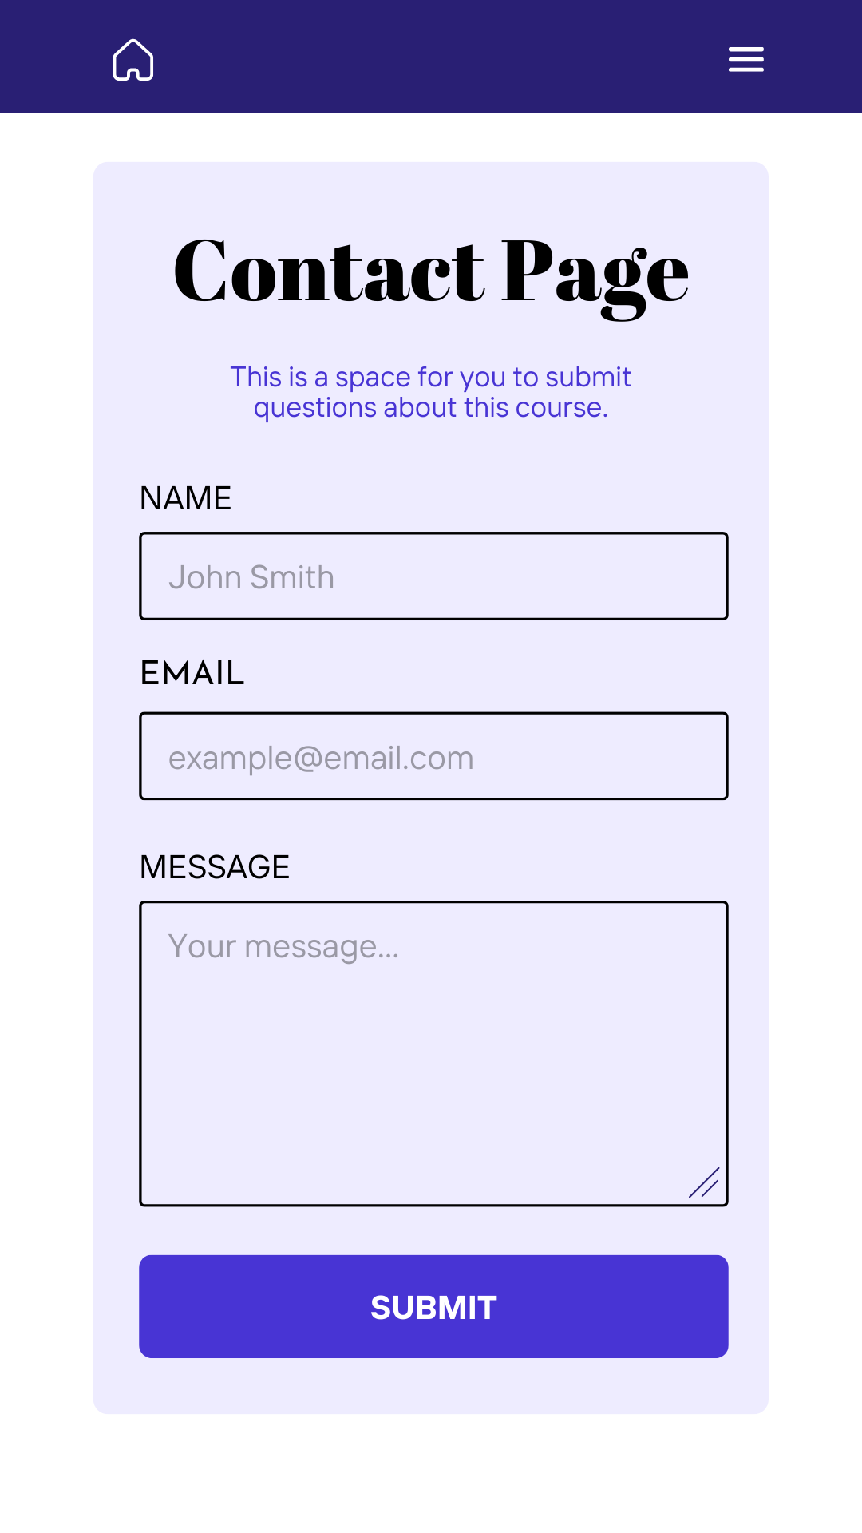

v
v

Slide 22
v
v

Slide 23
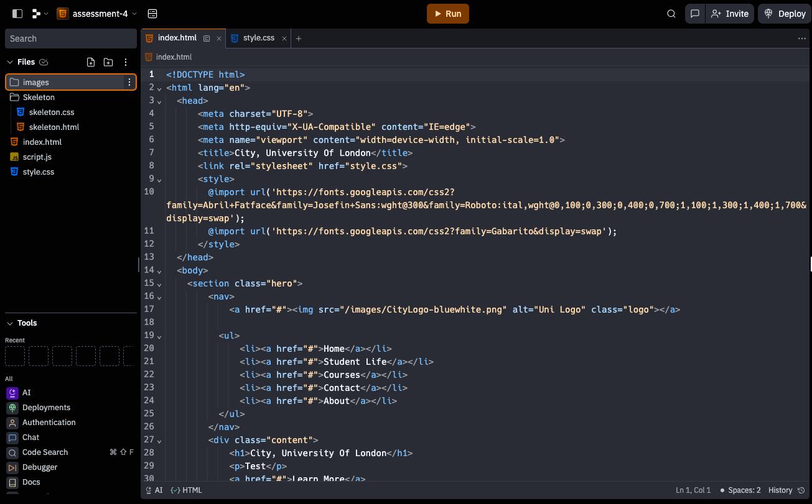
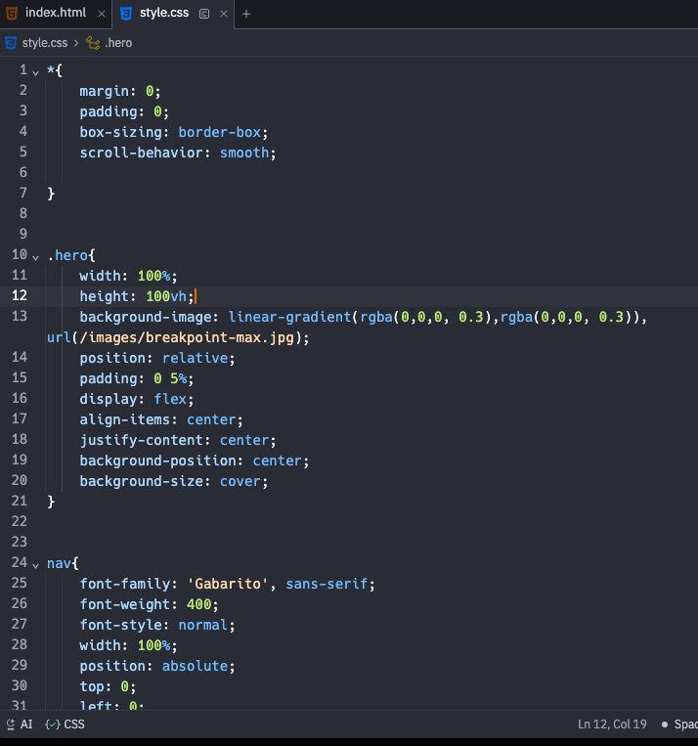
Code Progress

Slide 24
Thank You

